Slide 1
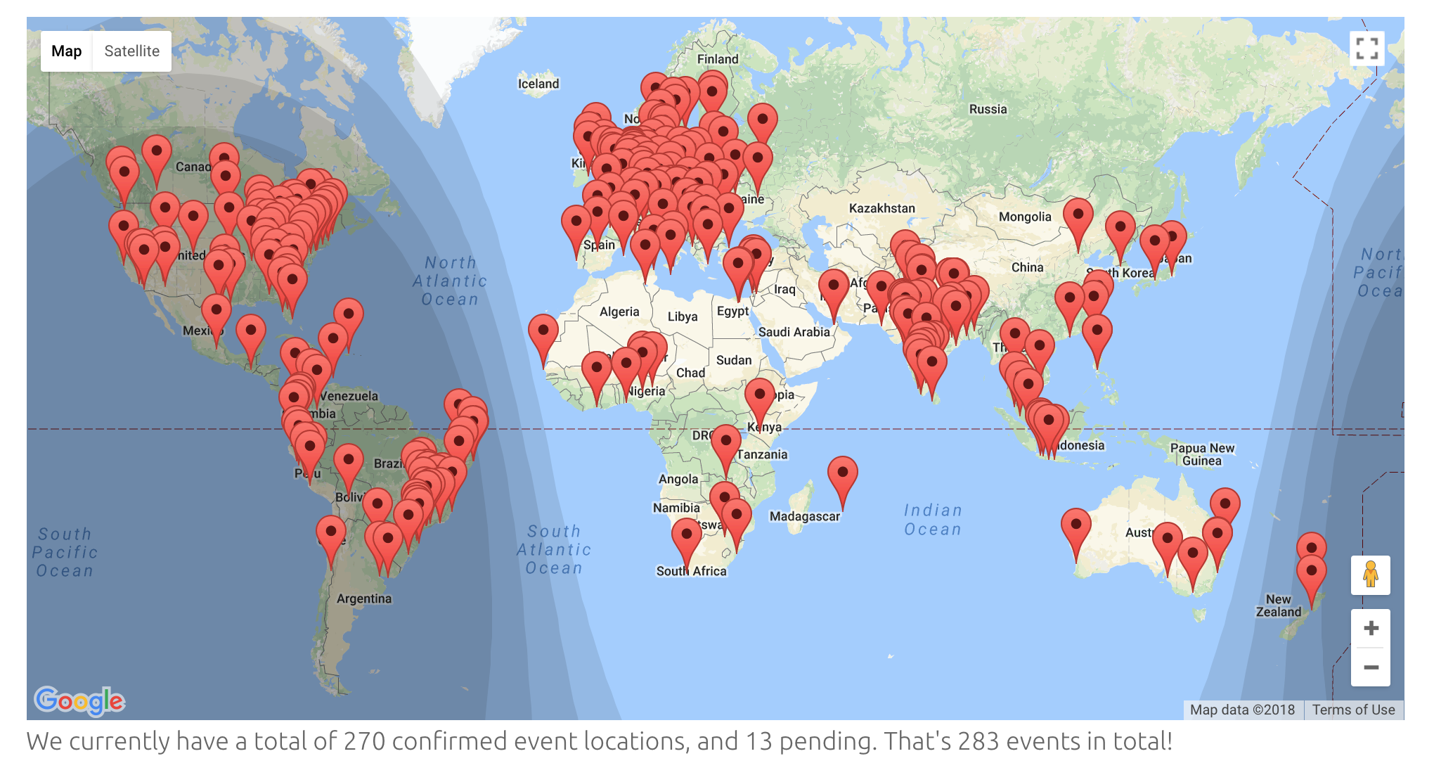
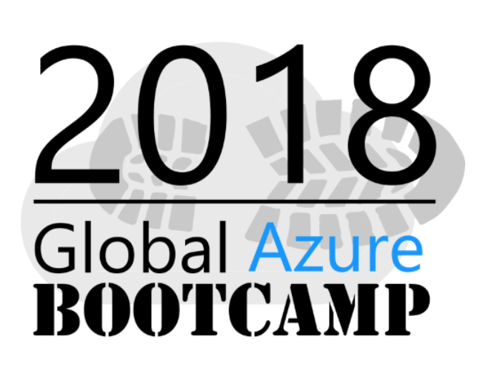

Slide 2
How To Learn Azure
and get certified into the process
@gregor_suttie

Slide 3
Welcome to the Global Azure Bootcamp
Glasgow
#GlobalAzure
Notes:
So Welcome everyone, this is my first time at one of the Azure Global Bootcamps, I hope you have fun today and learn some cool new stuff.
Thanks for coming out this morning and I hope I can spark your interest in learning some Azure.
Stop me at anytime to ask questions please, don't be shy, I'm just as nervous as you.
Lets dive right in.

Slide 4
Gregor Suttie
@gregor_suttie
https://gregorsuttie.com/
.Net Developer with 22 years experience Software Engineer / Devops / SRE
Continuous Improvement
Azure Fanboy
Keen Golfer
Notes:
I've currently a dev / sight reliability engineer and as it says I'm an azure fan boy and keen golfer although its not easy with the weather we have here in Scotland.

Slide 5
What level are you are At with Azure?
Notes:
1 - So raise your hand if your just getting started with Azure,
2 - Ok now raise your hand if your know some azure but want to know more
3 - And lastly who's pretty handy when it comes to knowing a fair bit about azure.

Slide 6
Why I wanted to learn Azure
Notes:
So last December I wanted to learn some cloud skills
Being a .Net guy obvious choice was Azure
So my talk today is basically about where I was then and where I am now and how I got there and its about being prepared to take on the exams.
If your not interested in the exams and just want to learn some Azure then your in the right place today.

Slide 7
Why should you get certified?
Its good to learn and get a certification out of it
You will learn something new and gain new skills
Bring something new to your job
You can play around with cool stuff
Notes:
Certifications don't mean that much to some of our managers and new hiring managers but if you want to learn something then why not get a certification out of it.
I promise you will learn new skills
When has that ever been a bad thing?

Slide 8
Section 1 – Info on the Azure Exams
Notes:
In section 1 I'll cover some background information on the exams, how much they cost, where can you sit them, how hard are they and why I think its good to do them

Slide 9
the Azure Exams are Tough
Notes:
Learning Azure may mean you have new skills and more experience about what service you could make use of and why
These exams take a fair bit of studying but becoming an MCP by passing one exam is a pretty cool feeling.

Slide 10
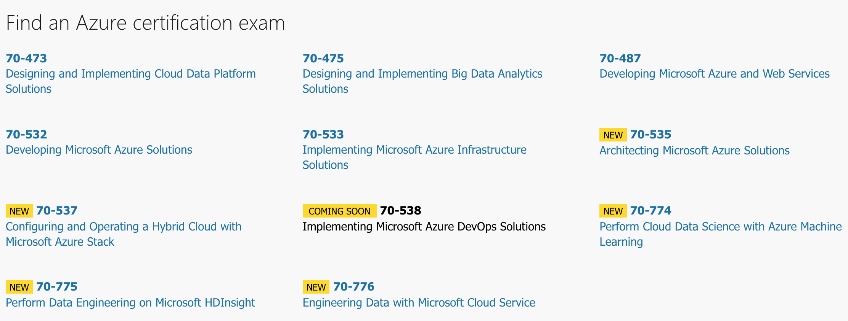
Microsoft Azure Certification Exams
Notes:
This screen shows the list of Azure exams available and the ones coming soon.
I myself and concentrating on 70-532, 70-533 and 70-535.
There are some interesting exams coming soon too

Slide 11
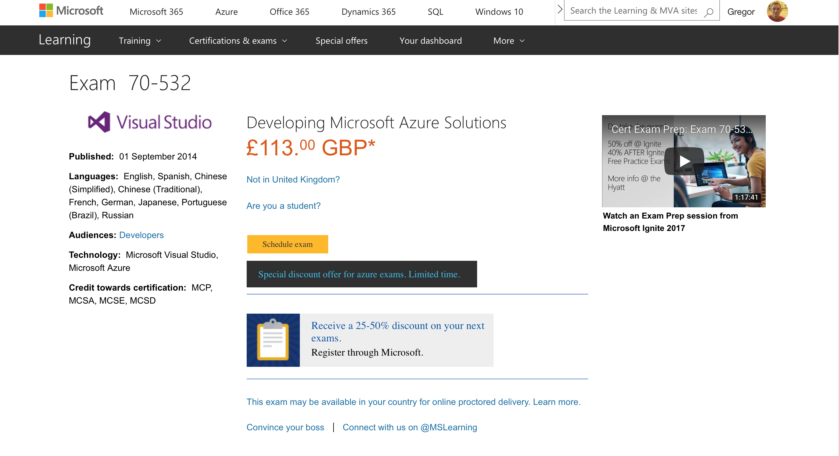
Notes:
Where can I find out more information about the exams themselves - official exam pages like this one.
Some sites do special offers so search around, things like discounted exam vouchers and retry options just incase you have to retake the exam.
You sit the exams either at a centre or from home

Slide 12
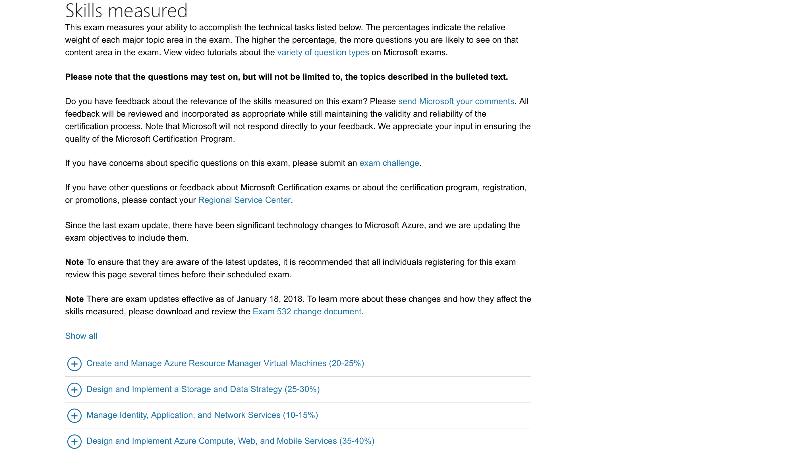
Notes:
This page will explain to you the skills being measured which you can look up on Microsoft docs
Keep an eye on this page before you sit your exam incase its updated
Note the score on each section as some sections are more heavily waited.

Slide 13
Section 2 – Azure Learning Resources
Notes:
Learning Azure may mean you have new skills and more experience about what service you could make use of and why which is pretty important and useful when your making decisions at work going forward.

Slide 14
Get started with a free Account
https://azure.microsoft.com/en-gb/free/
Notes:
You can get started with a free azure account which means you can go off and learn Azure and if your account expires or you go over the spend limit then simply create another account with a different email address and you wont ever be charged a single dime.

Slide 15
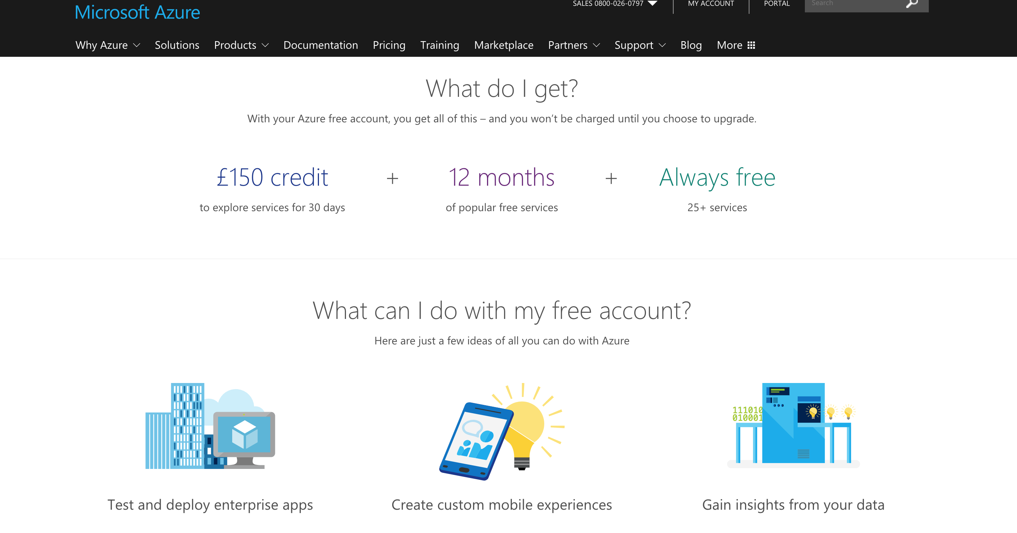
Notes:
So as you can see for example in the UK here we get £150 of credit to use for 1 month, which is quite a lot.
If you create resources in Azure its pretty wise to delete them once your finished using them so it doesn't keep burning your limit for the month.

Slide 16
Microsoft Azure Docs
https://docs.microsoft.com/en-us/azure/
Notes:
The official Azure documentation is amazing to be very honest with you, so much to learn, there are so many awesome samples and code snippets etc.
The actual docs are open sourced which means you can even do pull requests if you find something out of date or that isn't quite right.
I actually did my first ever OSS pull request to the docs team out with work and it was ridiculously easy to do.

Slide 17
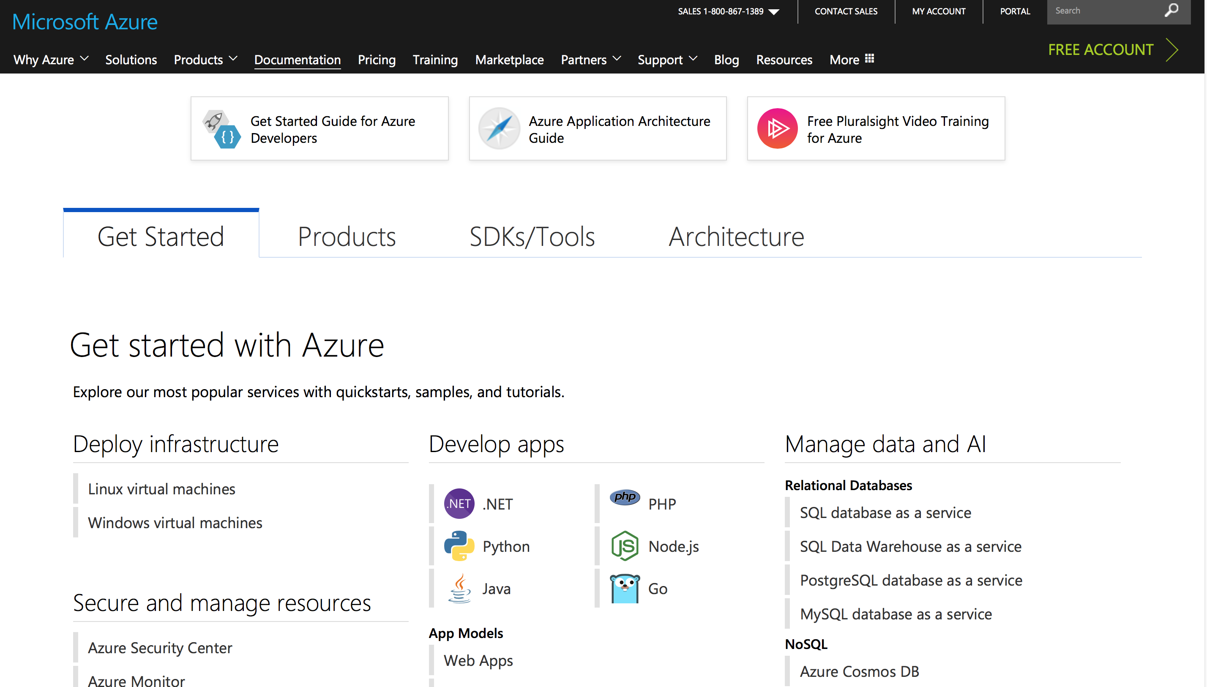
Notes:
The getting started section of Azure is particularly useful if like me you come to Azure with absolutely no idea where to start and how to get going so I'm mentioning this to help people get a starting point for learning Azure.

Slide 18
Practice Exams
https://uk.mindhub.com/microsoft-exam-replay-with-practice-test-mcp-exam/p/Microsoft-Exam-Replay-PT
Measure Up Practice Exams
https://crpietschmann.github.io/Azure-70-532-Practice-Test/
Notes:
Practice exams are very important and a great way to see how your progressing with your learning, start them right near the beginning of your learning and track your scores as you go through the training your doing.
Measure up exams are sometimes a little out of date so just bare that in mind when thinking about purchasing them.

Slide 19
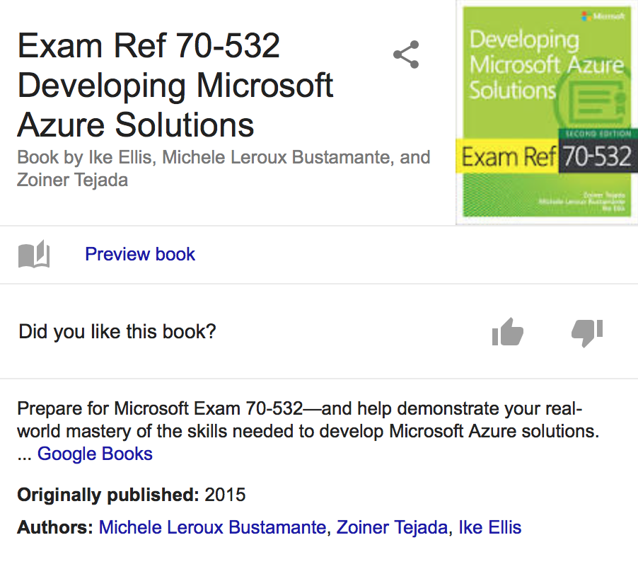
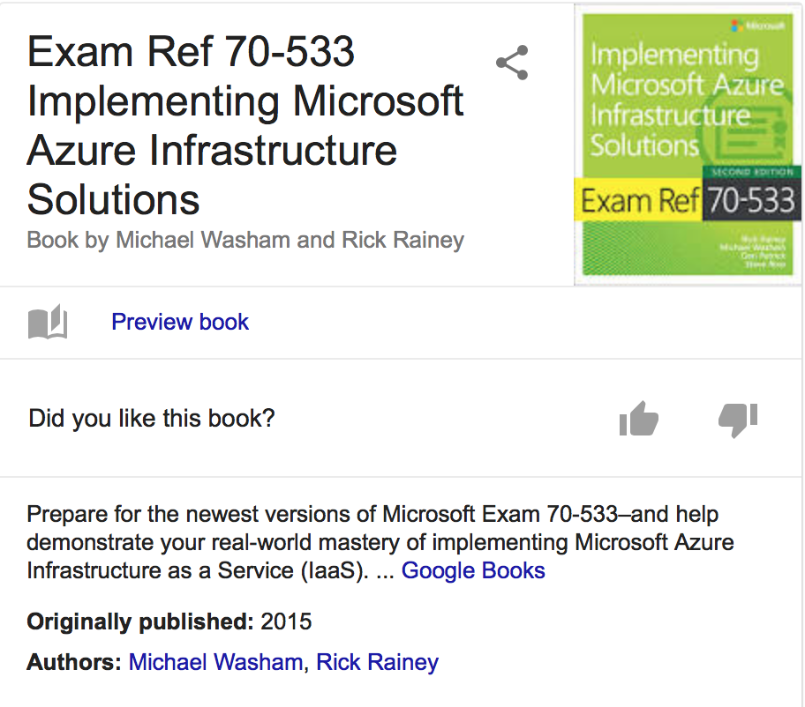
Official Exam Books
Notes:
The official books are pretty good even though they might be ever so slightly out of date by the time you want to sit the exams themselves, but they have good content still worth learning about.
They cover all aspects of the exam at the time of writing but can soon become out of date, if you can I recommend the ebooks a they are slightly cheaper.

Slide 20
Visual Studio Essentials

Slide 21
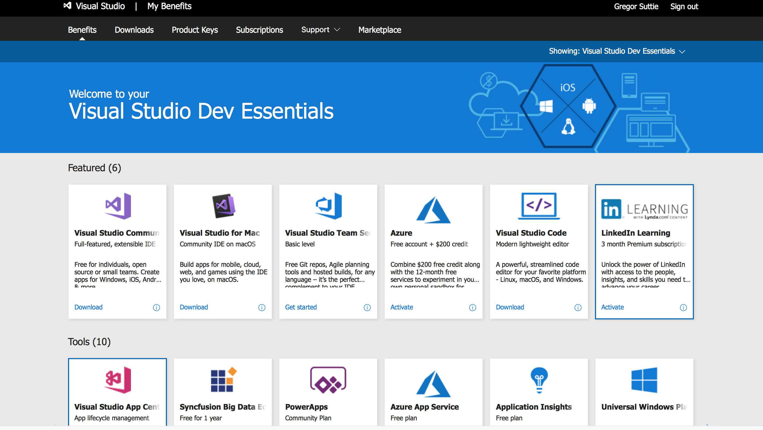
Notes:
Visual studio essentials is a list of free resources, training and special discounts / offers you get from Microsoft and all you have to do is sign up for free.
There is quite a lot of nifty tools and features that they give away free or give you access to for a certain length of time.
LinkedIn Learning actually has some very good content.

Slide 22
Pluralsight courses and learning plans
Barry LuIJbregts, ScotT Allen, Matt Milner, Mike Pfeiffer
Notes:
Plurasight have thousands of courses on a huge variety of technologies and the people listed here are the authors of the courses which I watched.
I just wanted to mention the names on the screen as these courses I highly recommend you watch.

Slide 23
Free Azure Pluralsight Courses
https://azure.microsoft.com/en-gb/training/free-online-courses/
Notes:
Plurasight have thousands of courses on a huge variety of technologies and the people listed here are the authors of the courses which I watched.
I just wanted to mention the names on the screen as these courses I highly recommend you watch.

Slide 24
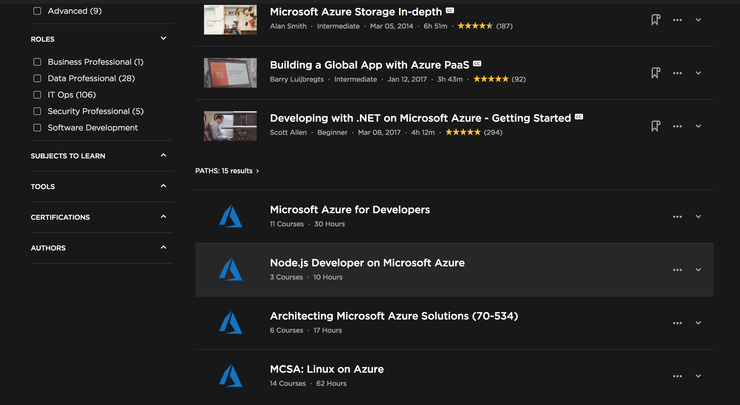
Notes:
So here I have searched on Pluralsight for azure and I recommend their learning paths, a few of them have a lot of content which you wont want to miss out on.
Learning Paths all cover beginner, intermediate and advanced levels - so again something for everyone.

Slide 25
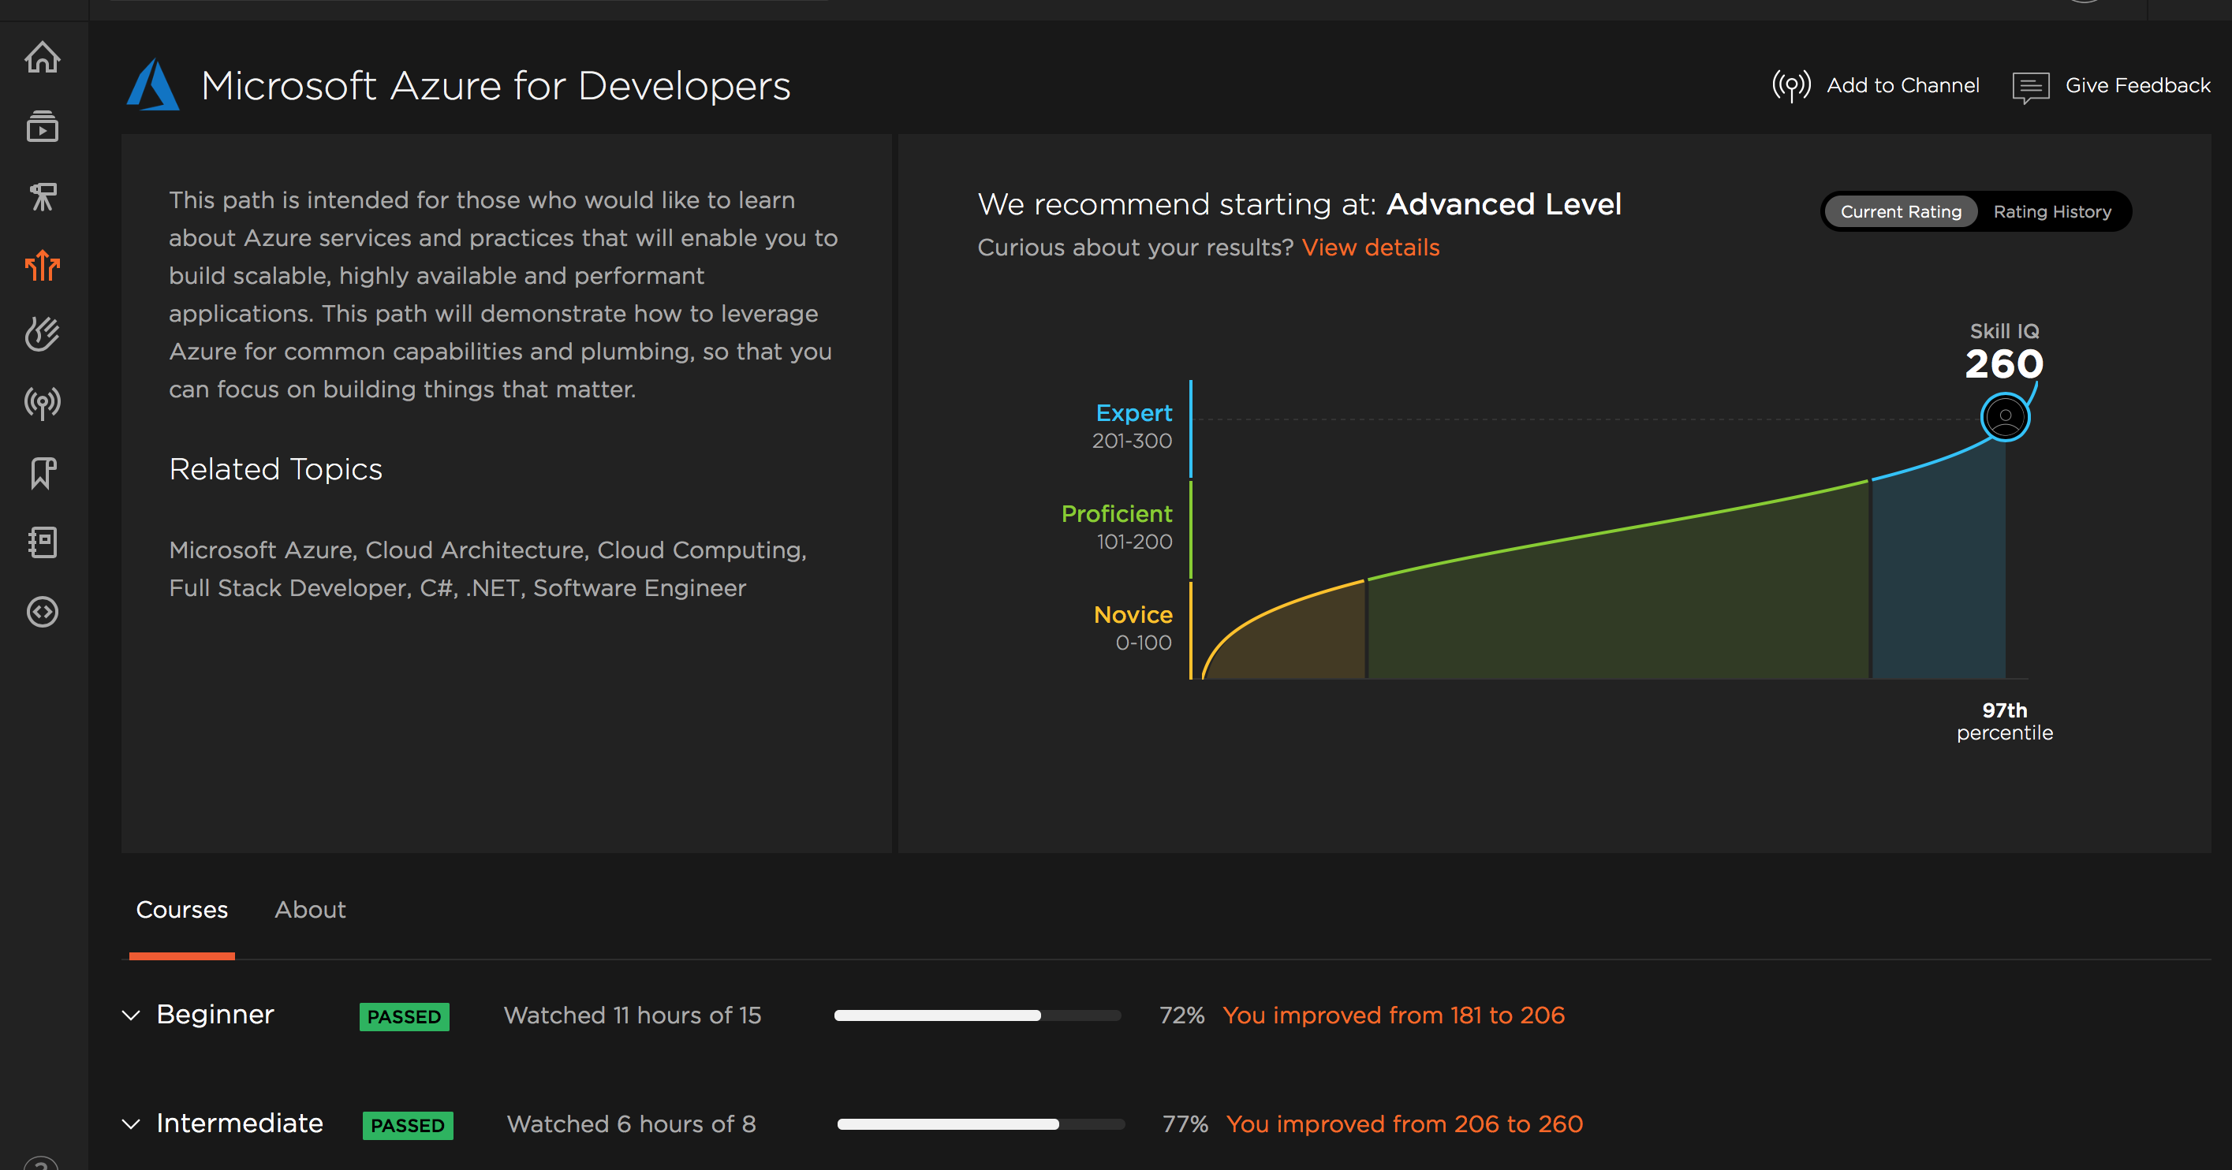
Scott Duffy
Notes:
The learning plans even have a score tracker so you can see if your skills are improving over time.
The first time I tried this I got proficient which made my day and the last time I tried it recently I managed to get Expert level rating - I wouldn't go that far but I at least knew the answers to the questions being asked.

Slide 26
Udemy Courses
Scott Duffy
Notes:
Scott Duffy is an author of several Azure courses on Udemy - I purchased these and highly recommend them even if your not wanting to go for the Azure exams.
For each exam he covers everything on the Microsoft exam page and also has a set of tests for each exam.
Again highly recommended.

Slide 27
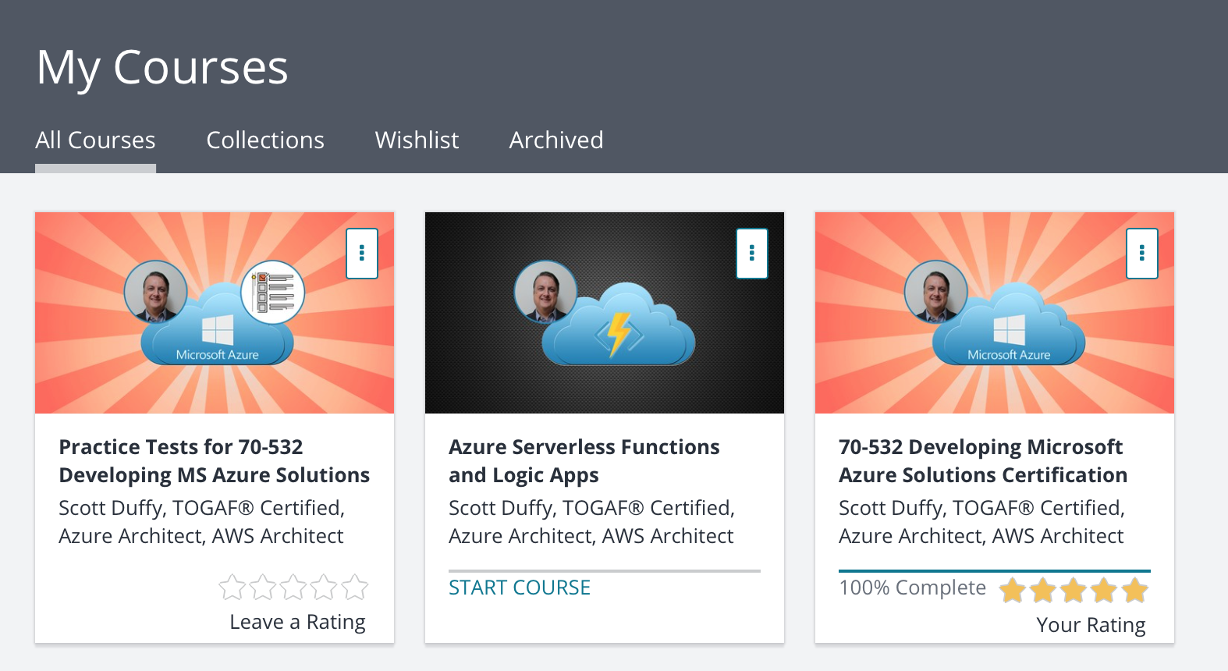
Notes:
These are the 3 courses which I purchased and I found them to be great for learning Azure and showing you code samples etc.

Slide 28
Azure Friday

Slide 29
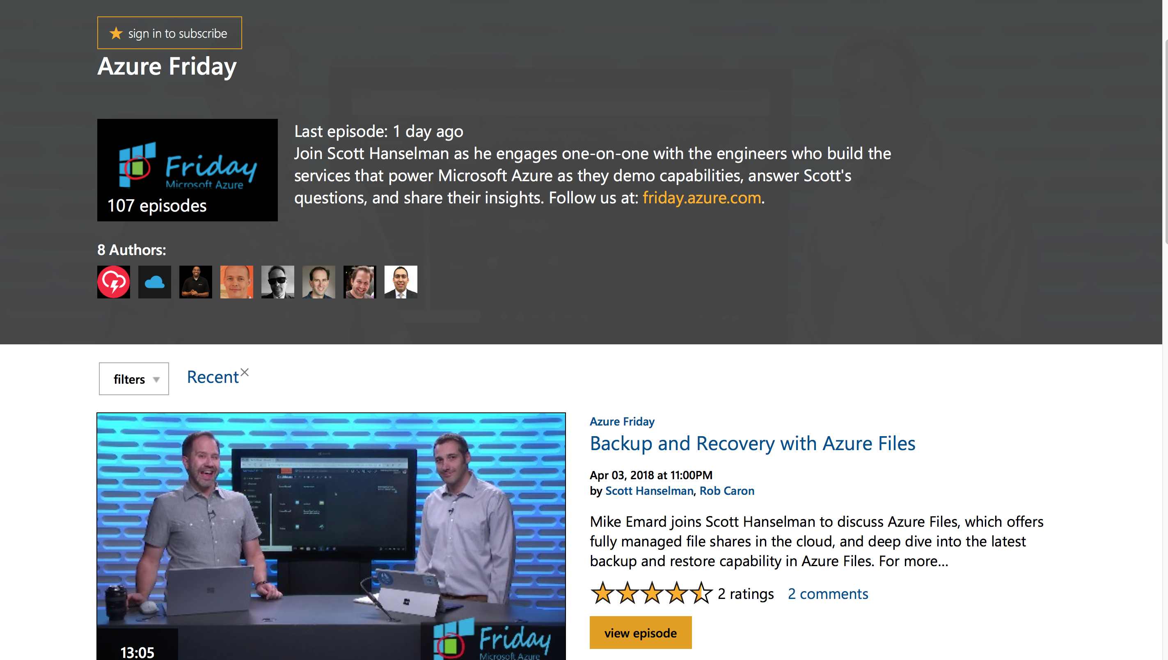
Notes:
Azure Friday - Join Scott Hanselman as he engages one-on-one with the engineers who build the services that power Microsoft Azure as they demo capabilities, answer Scott's questions, and share their insights.

Slide 30
Section 3 – What Can I expect to learn ?
There are many cool things to learn about in Azure

Slide 31
Azure Periodic Table

Slide 32
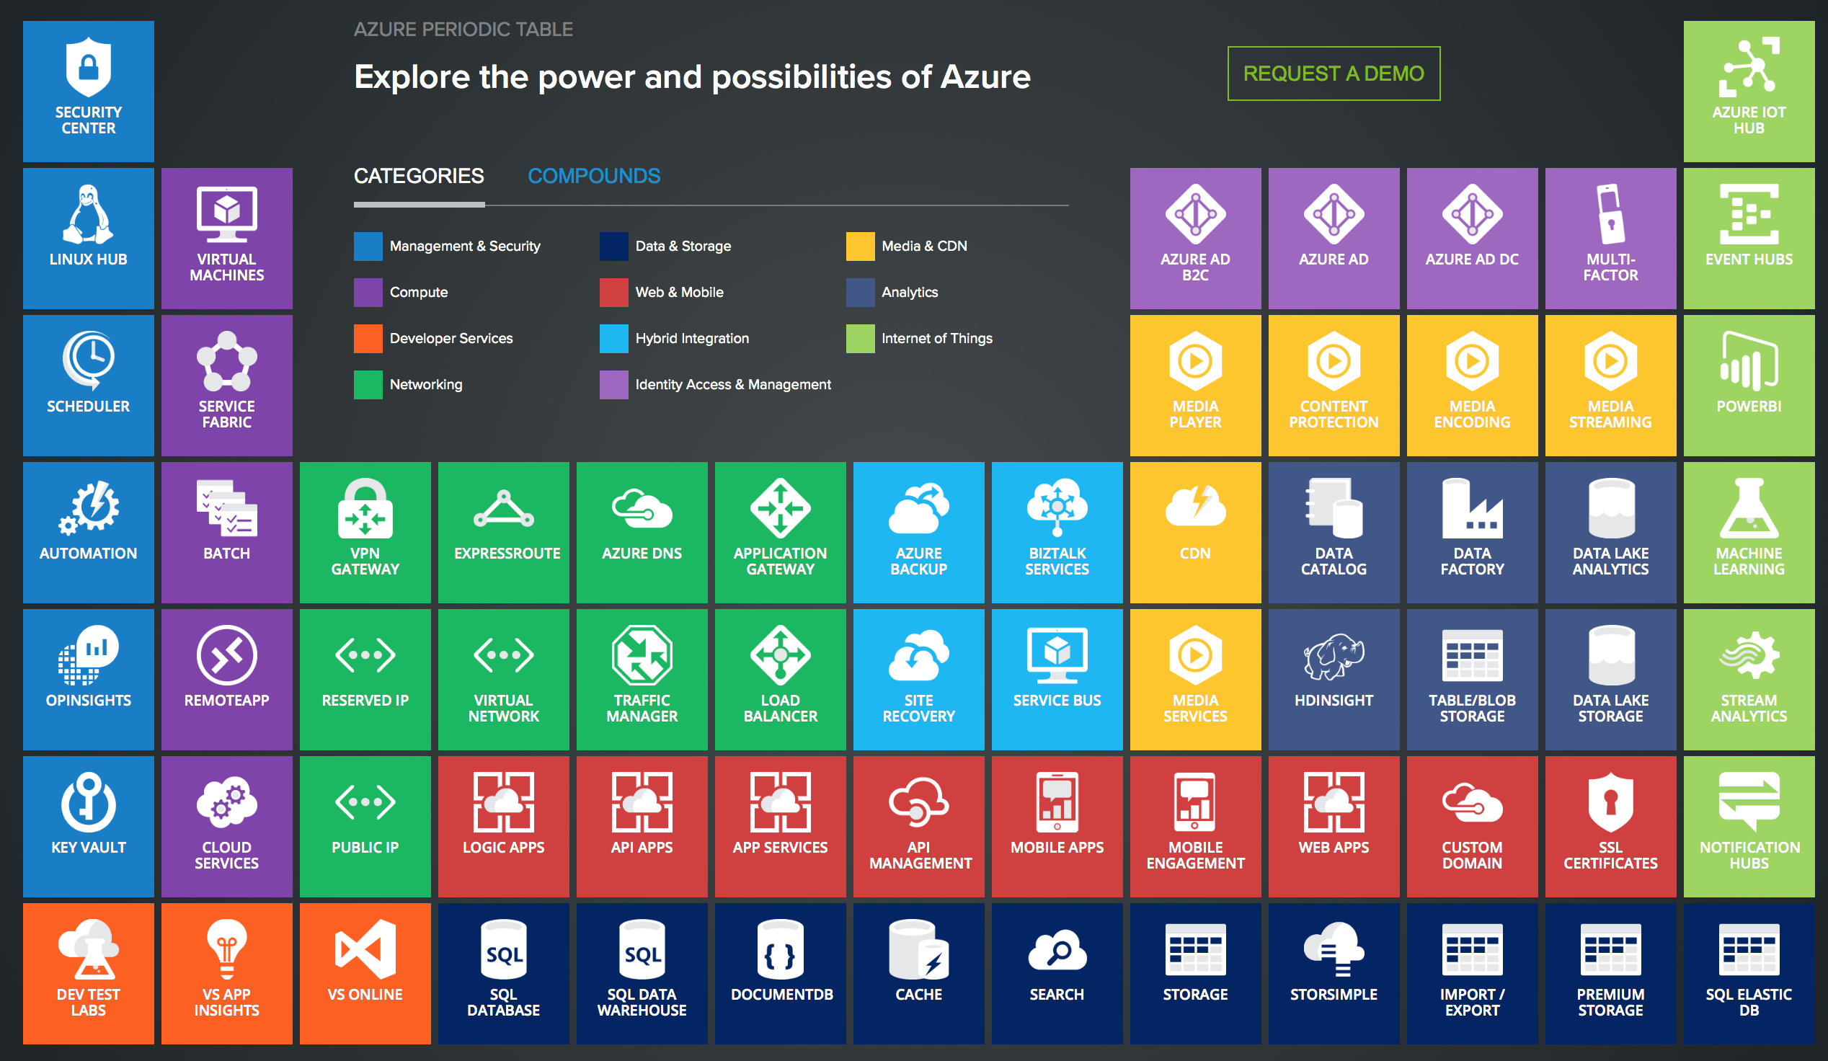
Notes:
Here is a list of just some of the services available with Azure, they include things like Key Vault, Azure Automation, Storage, VS Online and Dev Test Labs

Slide 33
Azure Interactives
https://azureinteractives.azurewebsites.net
Notes:
Azure interactives is a very cool website which shows you what's available and gives you a lot of information on each of the services available.

Slide 34
Logic apps, Web apps, Api Apps & API Management, Compute, Databases, Networking, Security, Function Apps, VM’s, CI/CD with Visual Studio Team Services and so much more

Slide 35
Summary
Sitting the Azure exams will benefit your career
Its free to learn
Its fun to learn new cool Stuff
Exams are tough
Prepare well
Notes:
Just going through some of the content I have talked about will help you learn aspects of Azure even if your not interested in attempting the exams themselves.
Its free to learn azure sign up for

Slide 36
Any Questions?

